Slide 1



Software Development and Professional Practices
Introduction to Git and Github

Slide 2
Course Goals
An understand the software engineering in terms of requirements, design, and implementation;
An understanding of how to use interaction diagrams to help define requirements;
Producing a software design based on requirements;
Producing software, including graphical user interfaces, from a design;

Slide 3


Motivation
Our societies could not function without large professional software systems.
Banking systems, automation systems, transportation systems, ERP systems, medical systems

Slide 4


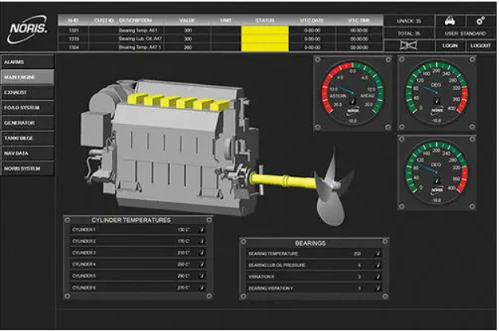
Motivation
Software engineering is an industry
We have to design large and critical systems carefully
Your system must be secure and reliable

Slide 5
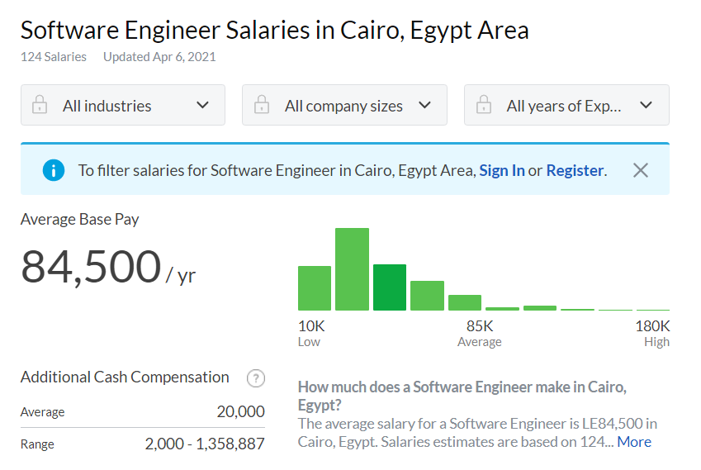
Motivation
Software engineering is a challenging job.

Slide 6
Motivation
Software engineers
Characteristics and ethics
Keep Learning
Ownership and Meaningful Work
Fault Tolerance
Business Decision-Making
Teamwork
Innovation and Problem Solving
Working at Amazon: Software Engineer

Slide 7
Lab content
Introduction to Git and Github
Clone Your GitHub Repository To Your Local Machine
Basic Workflow
Pulling Changes
Merge Conflicts
Branching

Slide 8
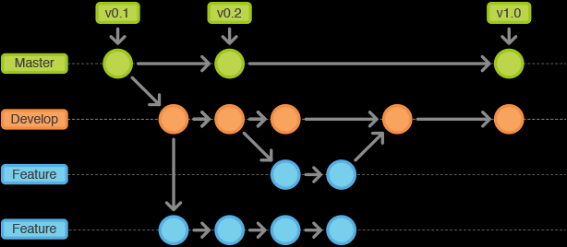
Git and Github
Git is a distributed version control system (VCS) designed to be fast and simple.
A VCS is a kind of software helps the developer team to communicate and manage all the changes made to the source code along with the information like who made and what change has been made.

Slide 9
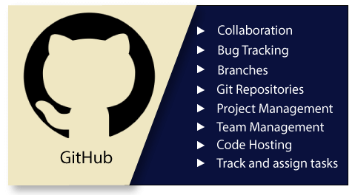
Git and Github
GitHub is a code hosting platform for version control and collaboration.
We will use GitHub as the remote server for storing our repositories.

Slide 10
Git and Github
Create a Github account.
Let’s create a Git_Demo repository
Click on "Create new..." button (+ sign) and select "New repository“
Fill in the information in the next page
Click Create Repository
Install Git on your local machine

Slide 11
Lab content
Introduction to Git and Github
Clone Your GitHub Repository To Your Local Machine
Basic Workflow
Pulling Changes
Merge Conflicts
Branching

Slide 12

Clone Your GitHub Repository To Your Local Machine
Clone the repository from Github to your local machine
Go to your GitHub repository, click on “Code" button and copy the link to your repository
Go to your working directory, and open Git bash inside it, OR open the CMD.
Write “ $git clone<repo link>$ “
Enter your credentials if required.

Slide 13
Clone Your GitHub Repository To Your Local Machine
In Git, there are 3 main states your files can be in:
A file is in modified state if it is modified but has not been committed to the database of your repository.
Committed
Modified
Staged
A modified file is in staged state if its current version is marked to go into your next commit snapshot (using commands like add, mv, reset, rm)
A file is in committed state if it is safely stored in the database of your repository (using commit command)
Github provides another state, called pushed if a committed file is stored in remote repository (using push command).

Slide 14

Clone Your GitHub Repository To Your Local Machine
You can check your files status using $"git status“$ command.
You must change to the directory of the repository using $"cd“$ command
Write $cd<Folder Name>$

Slide 15
Lab content
Introduction to Git and Github
Clone Your GitHub Repository To Your Local Machine
Basic Workflow
Pulling Changes
Merge Conflicts
Branching

Slide 16

Basic Workflow
Let’s follow the basic workflow
Create a new txt file inside the repo.
Modify the file by entering some text
Stage the changes: $git add<filename>$
Commit the changes: $git commit −m "This is a message“$
Push the commits to Github: $git push origin main$
To revert a commit
Use $"git revert <commit>“$
Write information message
Press INSERT button then press ESC button on the keyboard
Write :wq then press ENTER from the keyboard

Slide 17

Basic Workflow
To cache your credentials, use the command:
$git config --global credential.helper wincred$

Slide 18
Lab content
Introduction to Git and Github
Clone Your GitHub Repository To Your Local Machine
Basic Workflow
Pulling Changes
Merge Conflicts
Branching

Slide 19

Pulling Changes
Very often, your remote repository is changed (e.g. by you or your teammates) and you need to update your local repository accordingly. You can do that using pull command (You should commit your local changes first).
Edit the file on your github repo
Click on commit changes button
Go to your local machine and write: $git pull$
Notice the updates on your file

Slide 20
Lab content
Introduction to Git and Github
Clone Your GitHub Repository To Your Local Machine
Basic Workflow
Pulling Changes
Merge Conflicts
Branching

Slide 21

Merge Conflicts
Sometimes you may have conflicts when you merge the same code block that was modified in different repositories.
For example, on GitHub, modify a line in your file and commit it. Modify the same line in the file of your local machine and commit it
Pull the changes in your local repo using: $git pull$
" <<<<<<<" and " >>>>>>>" denote a conflict block. Content before " =======" is on your local machine, and content after " ======= " is on the remote repository (GitHub).
Remove the conflicts, then $add$, $commit$, and $push$your file

Slide 22
Lab content
Introduction to Git and Github
Clone Your GitHub Repository To Your Local Machine
Basic Workflow
Pulling Changes
Merge Conflicts
Branching

Slide 23
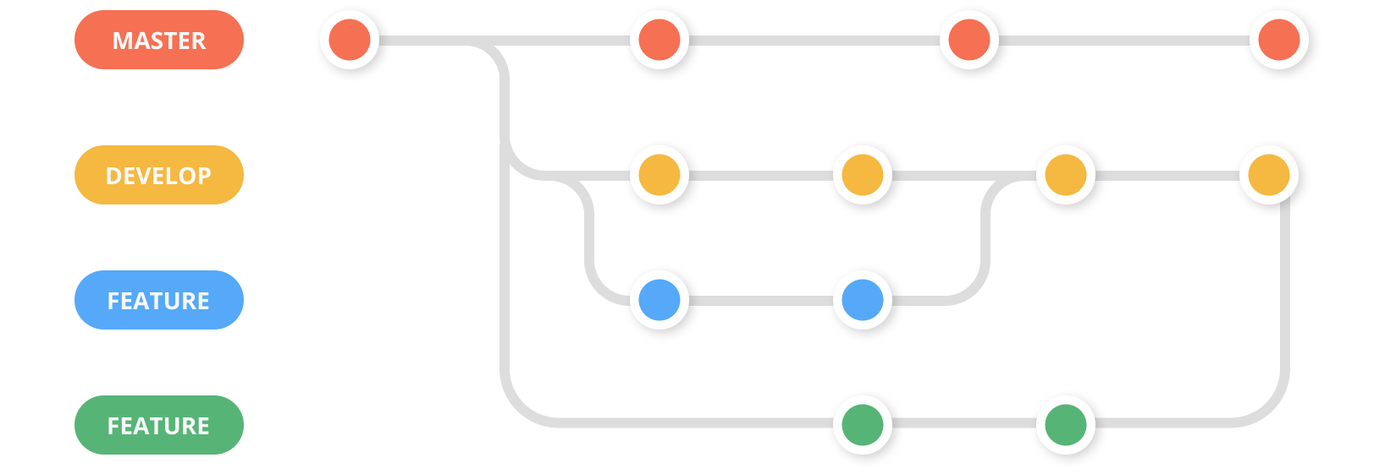
Branching
A branch can be considered as a development line.
Your main repository will keep adding new updates, bugs, fixes, tests, .... and moving between commits.
When you create a new repository, Git automatically creates a branch "master“ or “main”.

Slide 24

Branching
Create branches using: $git branch<name>$
$git branch testing$
$git branch features$
To see your branches and which branch you are working on, you use:
$git log−−oneline −−decorate$
The HEAD pointer indicate that we are at master branch.

Slide 25

Branching
Switch branches using: $git checkout <branch_name>$
$git checkout testing$
$git\log{ −−oneline −−}decorate$

Slide 26
Branching
Working and Merging Branches
Create “test.txt” file in testing branch
Switch to the features branch
Create “feat.txt” file in features branch
Switch to main branch
Merge other branches to main branch
Delete other branches

Slide 27
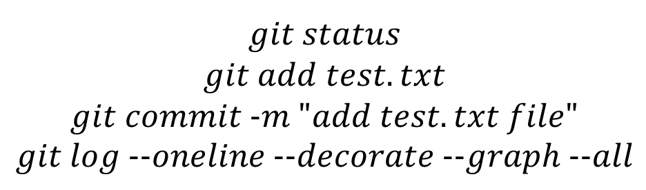
Branching
Working and Merging Branches
Create “test.txt” file in testing branch
$$echo "This is a test file" >> testing.txt$$
$$git status \\ git add test.txt \\ git commit -m "add test.txt file" \\ git log --oneline --decorate --graph --all$$

Slide 28
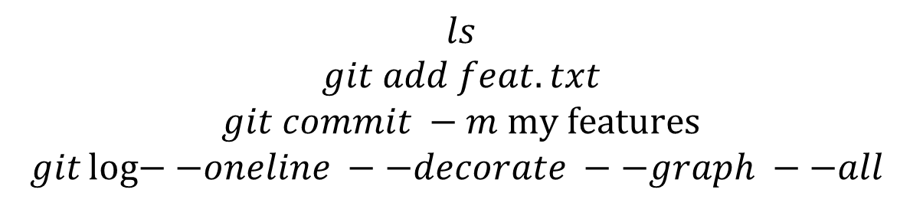
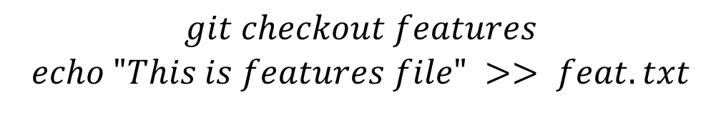
Branching
Working and Merging Branches
Create “test.txt” file in testing branch
Switch to the features branch
Create “feat.txt” file in features branch
$$git checkout features$$
$$echo "This is features file" >> feat.txt$$
$$ls$$
$$git add feat.txt$$
$$git commit −m \text{my} \text{features}$$
$$git\log{−−oneline −−decorate −−graph −−all }$$

Slide 29
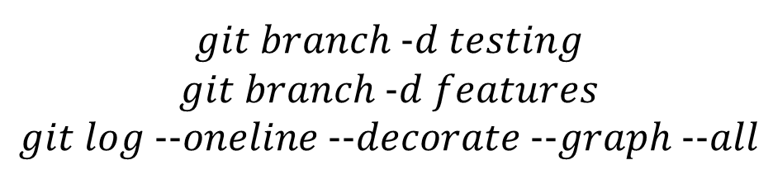
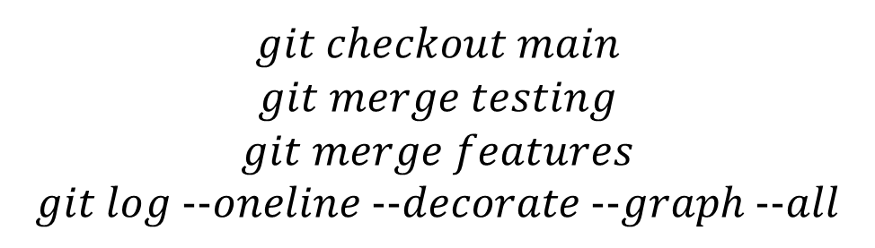
Branching
Working and Merging Branches
Create “test.txt” file in testing branch
Switch to the features branch
Create “feat.txt” file in features branch
Switch to main branch
Merge other branches to main branch
Delete other branches
$$git checkout main \\ git merge testing \\ git merge features \\ git log --oneline --decorate --graph --all$$
$$git branch -d testing \\ git branch -d features \\ git log --oneline --decorate --graph --all$$

Slide 30
Summary
You learned what is git and github
The files states in git: modified, staged, committed
Following a basic workflow
Pulling changes from remote repo
Creating and merging branches

Slide 31
Task
Install Git
Create a Github account, and create a new repository called “Soft_Dev lab”
Describe what is data-driven programming (search online)
Describe what is functional programming (search online)
Upload the answers to the previous two questions to Github in a text file

